Slide 1
Revised Client Problem Statement
Design a System that Implements a Demand Response Control/ Management of User Appliances during Peak Energy Consumption Periods by Exploring the Benefits of a Load Scheduling System in Time of Use(ToU) Utility Pricing.
The system will include a Central Control Unit (CCU) that Communicates with a Utility Portal via the Internet to Exchange pricing information with the user
The CCU will Communicate with Various Sensors and Components that will Control Time of Use of Certain Devices and Monitor their Energy Consumption

Slide 2
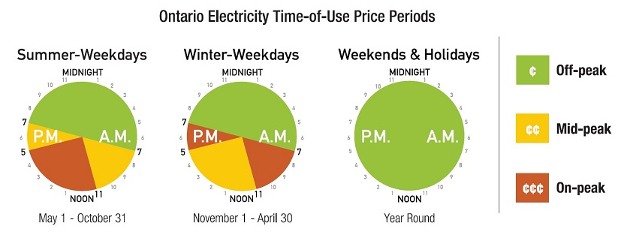
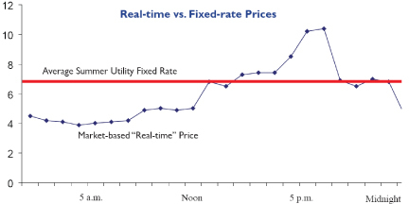
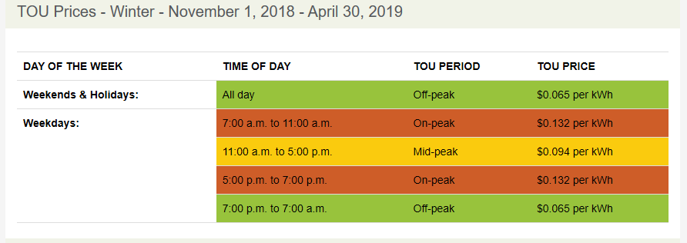

Time of Use (ToU) and Real Time Pricing

Slide 3
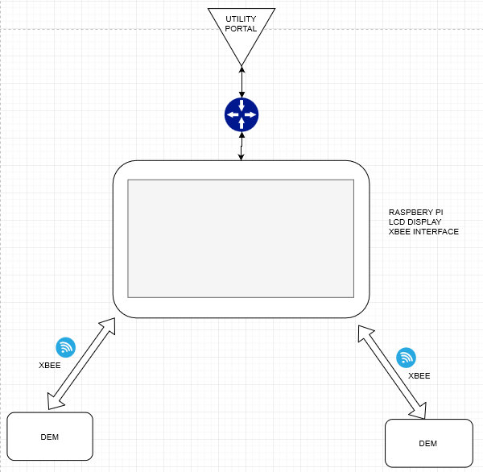
System Block Diagram
Central Control Unit (CCU)
Receive Data from Utility Portal
Process the Data/Request
Send Signals to the Device Energy Managers for load Scheduling
Device Energy Manager (DEMs)
Switch the Devices according to the Instructions from the CCU
Monitor Appliance Energy Usage
Send Usage Information to the CCU
CCU

Slide 4
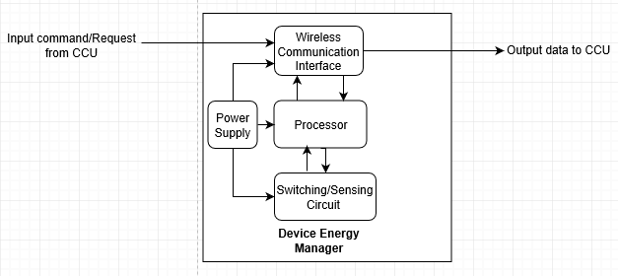
Sub-System : Device Energy Manager
Manage the Switching of the Desired Appliance

Slide 5
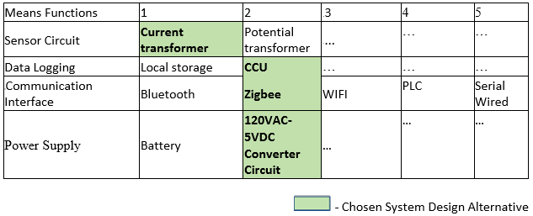
Sub-System 1: Device Energy Manager (DEM)
Measure the Energy Usage/Consumption (Optional) of the Desired Appliance
Switching Circuit | Relay | …… | …… | …… | ……

Slide 6
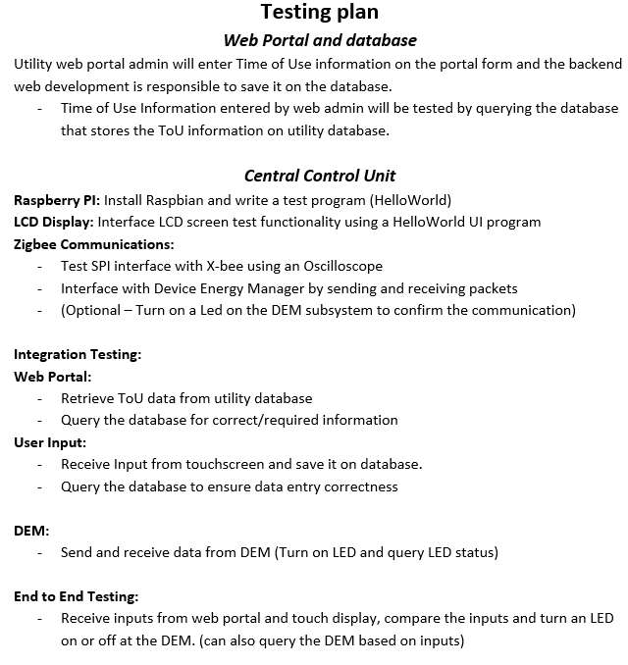
Testing Plan

Slide 7
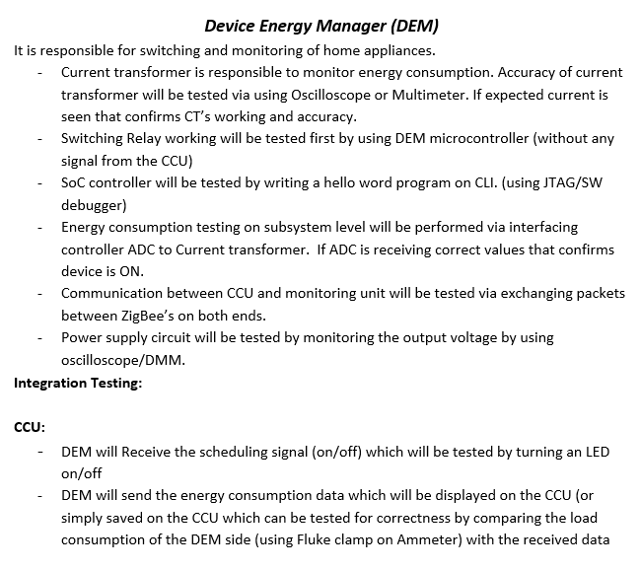
Testing Plan

Slide 8
Testing Plan – Division of Labour (Overall)
Dami - CCU
Design and Programming
Python based touchscreen User Interface Design
Process/display the data from the DEMs
Processing User Input for device/appliance scheduling (will be done by using ToU data from utility)
Sending scheduling information to the DEMs
Zigbee Communications
Enclosure Design and Fabrication (Optional)
Amandeep –
SoC Testing and Debugging
RF Antenna Design
DEM-Side Communication
Utility Database portal Design
CCU database design
Demo Load Electronics
Bikramjit – DEMs
Programming and Testing
PCB Schematic Design and Fabrication
Enclosure Design and Fabrication (Optional)
* This plan might be subject to revision/changes during the progress of the project

Slide 9
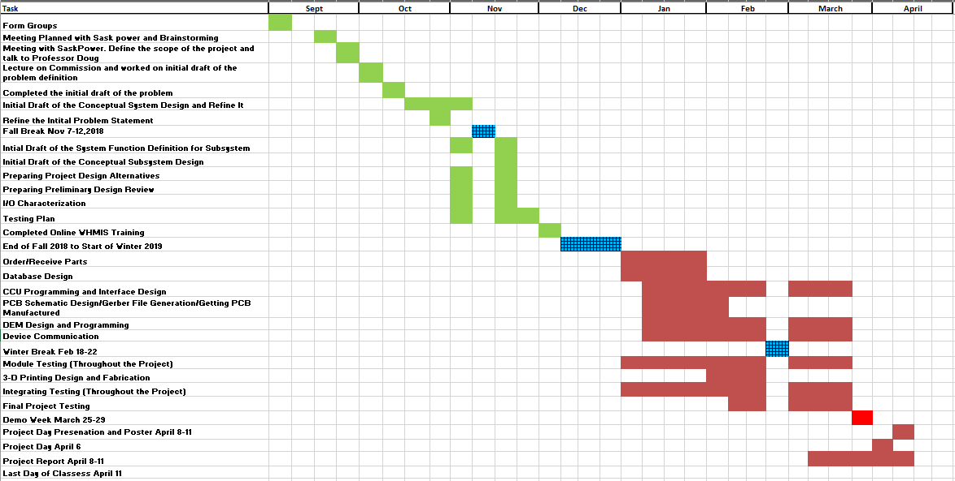
Gantt Chart

Slide 10
Questions

